Slide 1
Detection of Deepfakes
Speech Group 20/03/2024
Anthony White

Slide 2
Some features used for Deepfake detection
Short-time Fourier Transform (STFT)
Constant-Q Cepstral Coefficients (CQCC)
Linear Frequency Cepstral Coefficients (LFCC)
Mel Frequency Cepstral Coefficients (MFCC)
Gammatone Frequency Cepstral Coefficients (GFCC)
Modified Group Delay (MGD)
Biocoherence
Short-term Long-term features (STLT)

Slide 3
Short-term Long-term features (STLT)
Introduced in a 2021 paper “Synthetic speech detection through short-term and long-term prediction traces”
Investigates the behavior of synthetic speech in the source-filter model
Based on a short-term and long-term linear prediction analysis

Slide 4
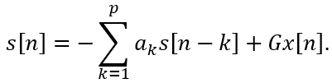
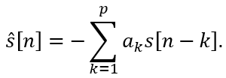
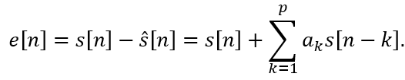
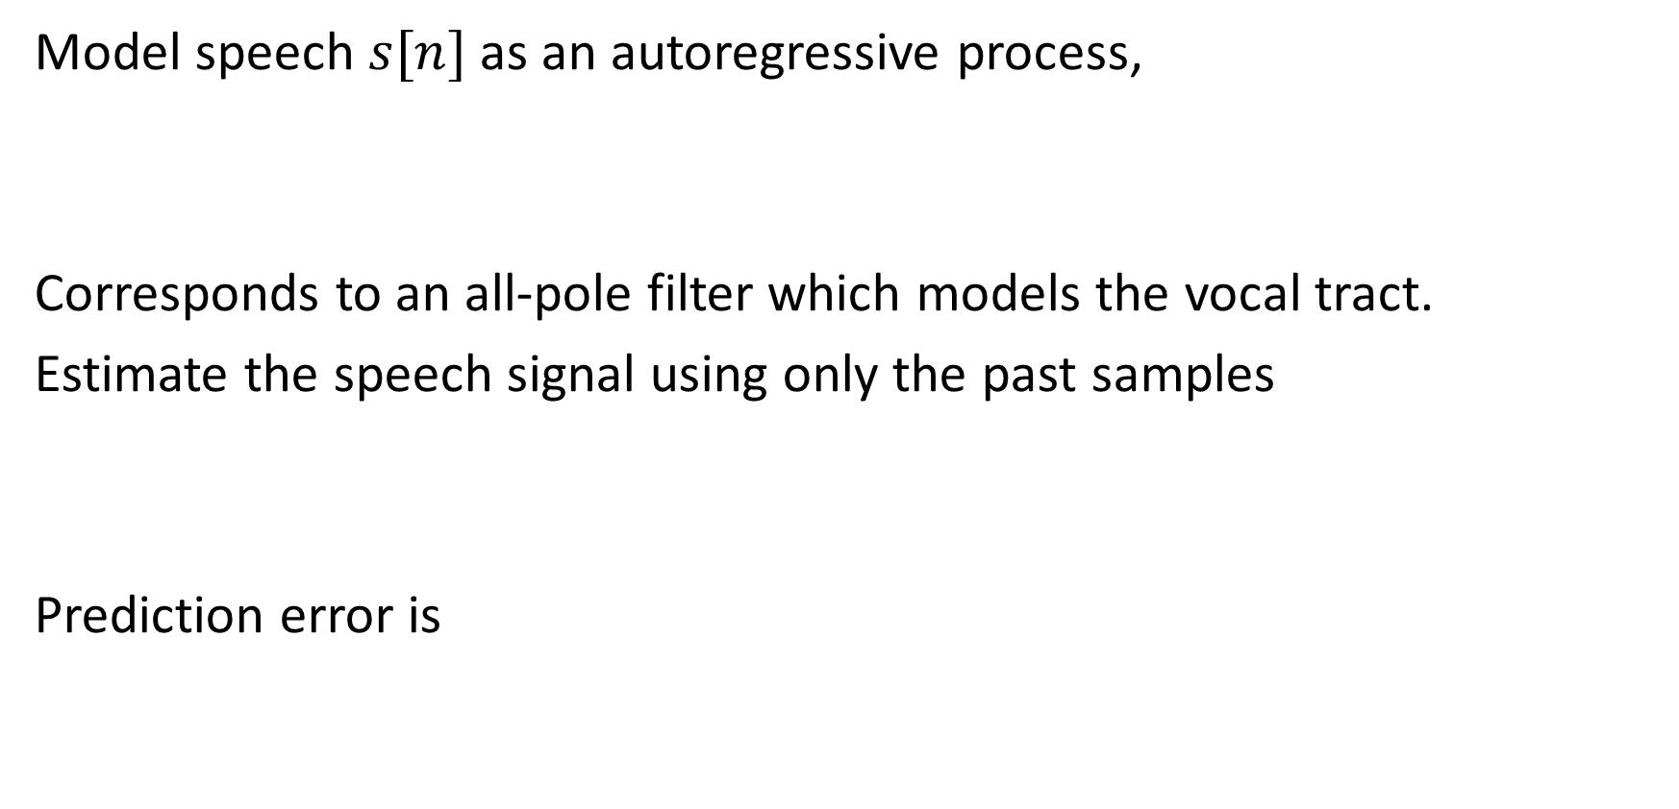
Short-term Linear Prediction
Model speech $s[n]$ as an autoregressive process,
Corresponds to an all-pole filter which models the vocal tract.
Estimate the speech signal using only the past samples
Prediction error is

Slide 5
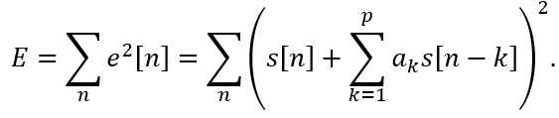



Short-term Linear Prediction
Minimise the total squared error,
When this is minimised, we get
where $R_{i}$ is the autocorrelation, defined as

Slide 6
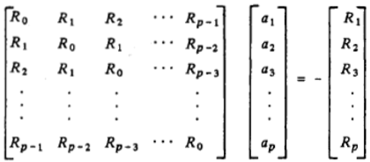
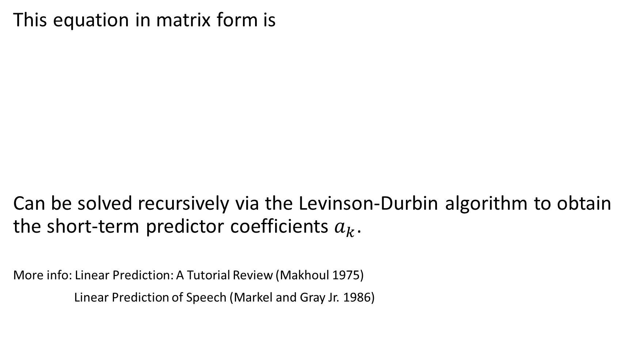
Short-term Linear Prediction
This equation in matrix form is
Can be solved recursively via the Levinson-Durbin algorithm to obtain the short-term predictor coefficients $a_{k}$.
More info: Linear Prediction: A Tutorial Review (Makhoul 1975)
Linear Prediction of Speech (Markel and Gray Jr. 1986)

Slide 7
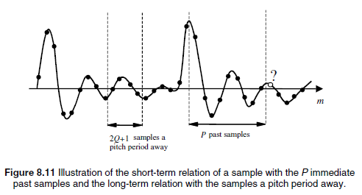
Long-term Linear Prediction
Speech is quasi-periodic. Long term prediction involves predicting the current sample based on a set of samples in the previous “period”.
Image from S. Vasgehi: Advanced Digital Signal Processing and Noise Reduction (Ch. 8)

Slide 8


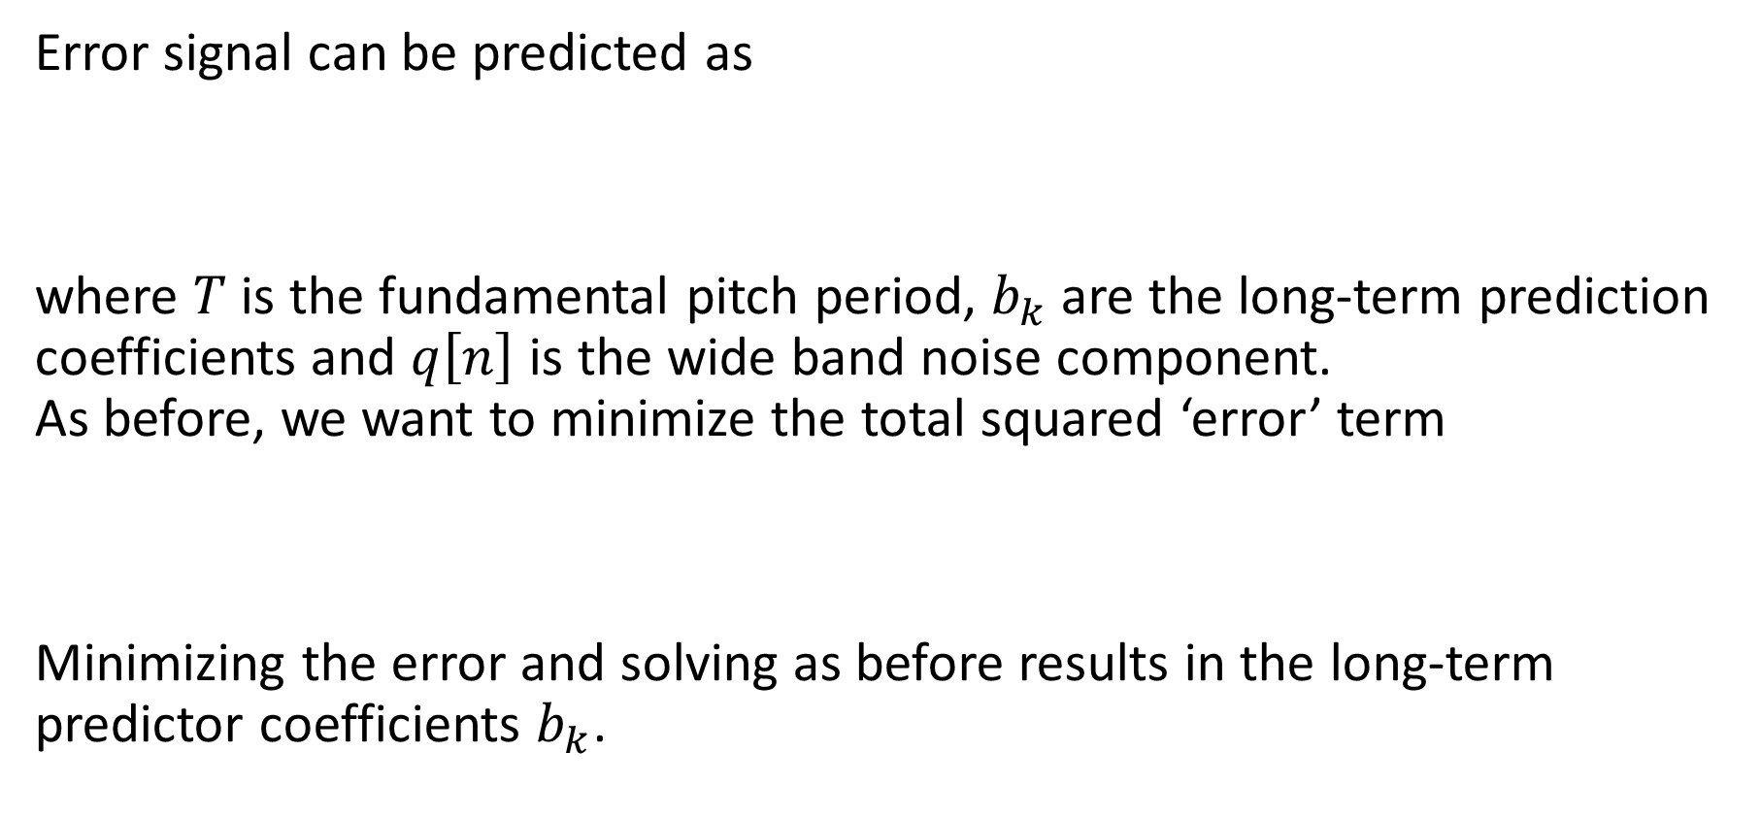
Long-term Linear Prediction
Error signal can be predicted as
where $T$ is the fundamental pitch period, $b_{k}$ are the long-term prediction coefficients and $q\left[n\right]$ is the wide band noise component. As before, we want to minimize the total squared ‘error’ term
Minimizing the error and solving as before results in the long-term predictor coefficients $b_{k}$.

Slide 9
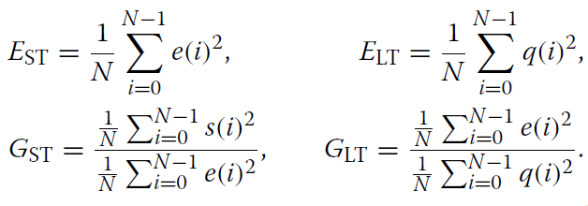
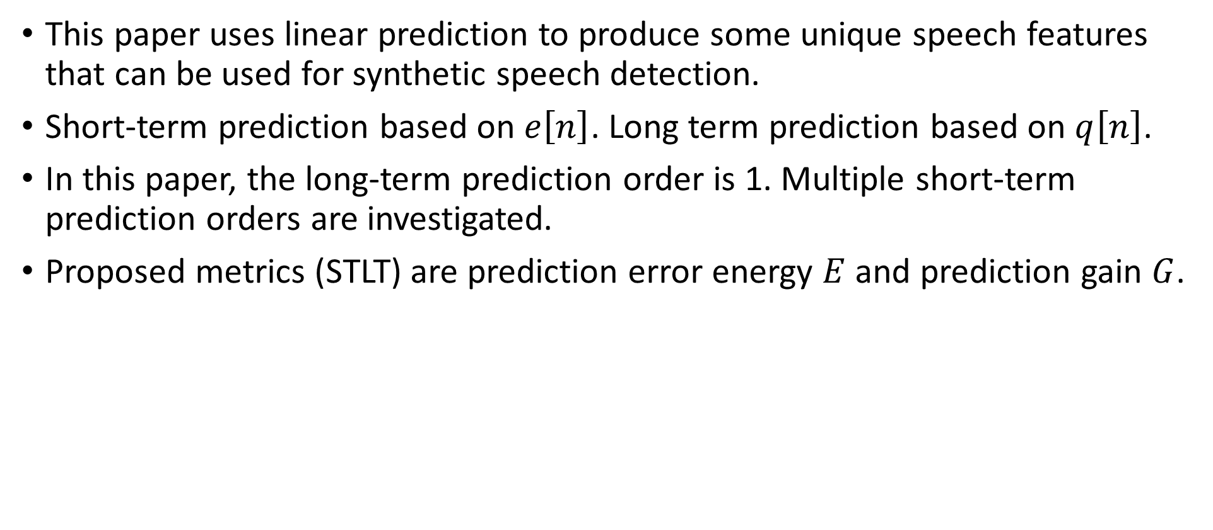
Synthetic speech detection through short-term and long-term prediction traces (Clara Borrelli, Paolo Bestagini, Fabio Antonacci, Augusto Sarti and Stefano Tubaro, 2021)
This paper uses linear prediction to produce some unique speech features that can be used for synthetic speech detection.
Short-term prediction based on $e\left[n\right]$. Long term prediction based on $q\left[n\right]$.
In this paper, the long-term prediction order is 1. Multiple short-term prediction orders are investigated.
Proposed metrics (STLT) are prediction error energy $E$ and prediction gain $G$.

Slide 10

Synthetic speech detection through short-term and long-term prediction traces (Clara Borrelli, Paolo Bestagini, Fabio Antonacci, Augusto Sarti and Stefano Tubaro, 2021)
In the experiment, the ASVspoof 2019 dataset is used.
Biocoherence is used as a baseline
Machine learning methods are used to classify the STFT features and biocoherence into synthetic/bona fide speech. Methods are random forest, linear SVM and RBM-SVM
Classifications are binary, closed set, open set.
SVM = Support Vector Machine RBM = Radial Basis Function

Slide 11
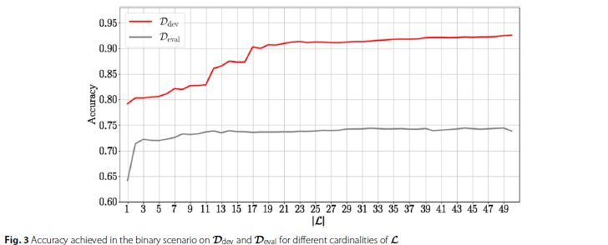
Synthetic speech detection through short-term and long-term prediction traces (Clara Borrelli, Paolo Bestagini, Fabio Antonacci, Augusto Sarti and Stefano Tubaro, 2021)

Slide 12
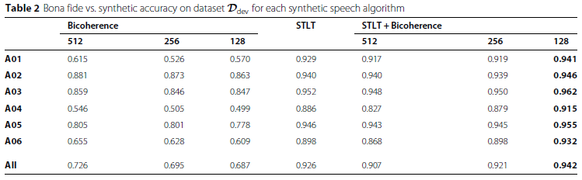
Synthetic speech detection through short-term and long-term prediction traces (Clara Borrelli, Paolo Bestagini, Fabio Antonacci, Augusto Sarti and Stefano Tubaro, 2021)

Slide 13
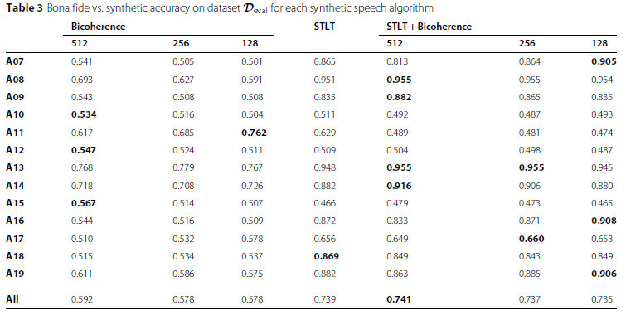
Synthetic speech detection through short-term and long-term prediction traces (Clara Borrelli, Paolo Bestagini, Fabio Antonacci, Augusto Sarti and Stefano Tubaro, 2021)

